Slide 1
Cell Behaviour Modelling Platform
Ryan Carey, Lewis Kindeleit, Antoine Messager

Slide 2
Design aims
Flexibly & efficiently
reproduce biologically realistic behaviour
Graphical or prompt
Graphical or binary
2

Slide 3
Agent-based models (ABMs)
Suited to modelling interdependent modules (e.g. cells)
Flexible
Can model heterogenous entities with heterogenous interaction network. (Kaul 2015)
Growing in popularity
3

Slide 4

Design choices
Agent-based models
Continuous space
Different types of cells
Environment modelled with PDEs
Julia Language
4

Slide 5
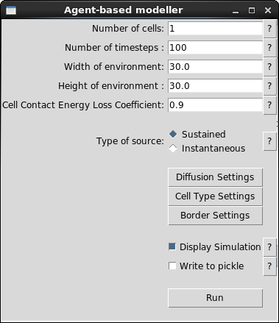
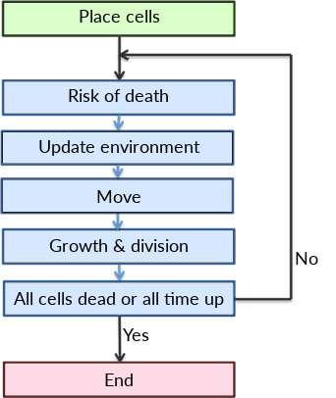
Model overview
5

Slide 6
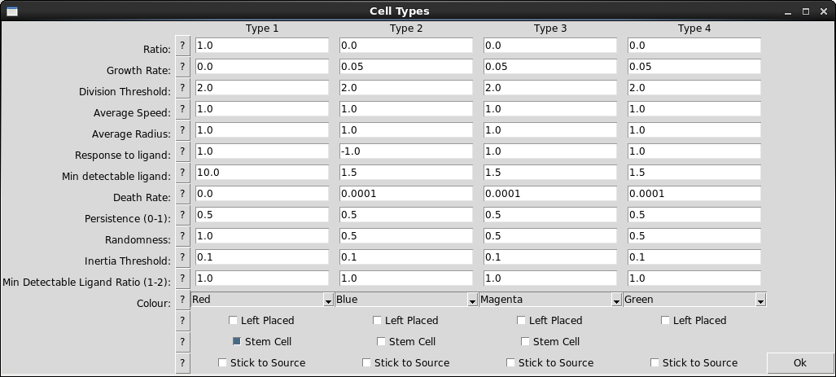
Cell Model Interface
6

Slide 7
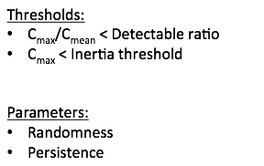
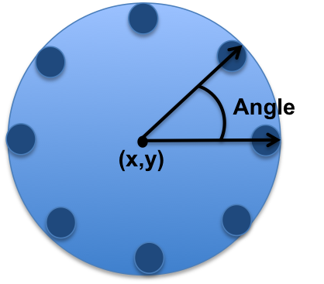
Cell Model
7

Slide 8
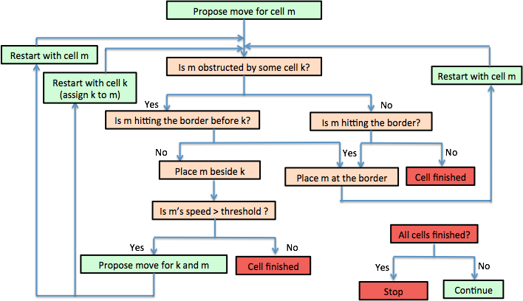
Cell Ballistics
8

Slide 9
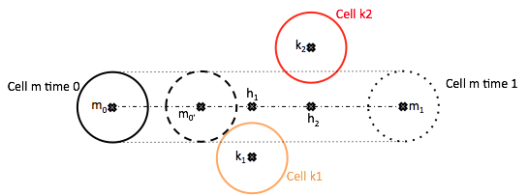
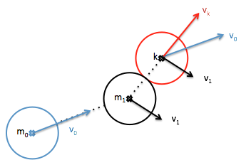

Cell-Cell Interaction
9

Slide 10
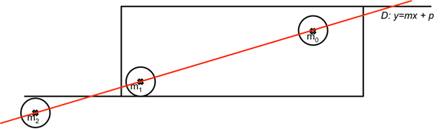
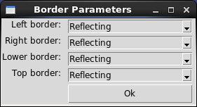
Cell-Wall interaction
10

Slide 11


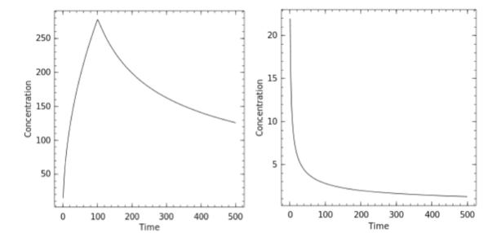
Diffusion
Sustained
Instantaneous
Plot of the concentration of ligands over time at a fixed distance from the source
11

Slide 12
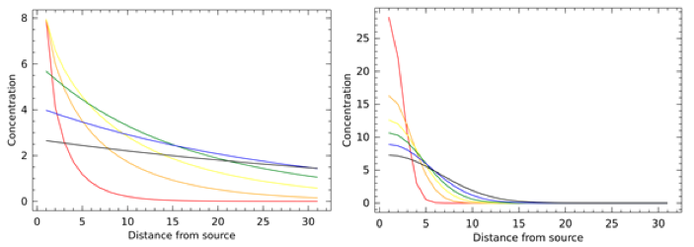
Diffusion Illustration
12

Slide 13
Diffusion Interface
VIDEO of the integrative diffusion instead and click on the location and coefficient button to show the other interface
13

Slide 14
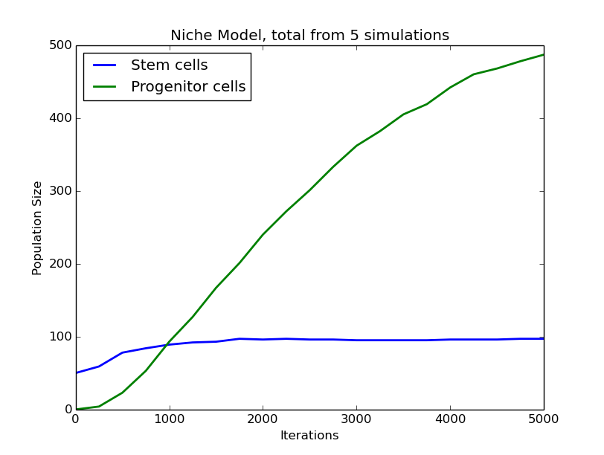
Example: Stem Cell Replication
14

Slide 15
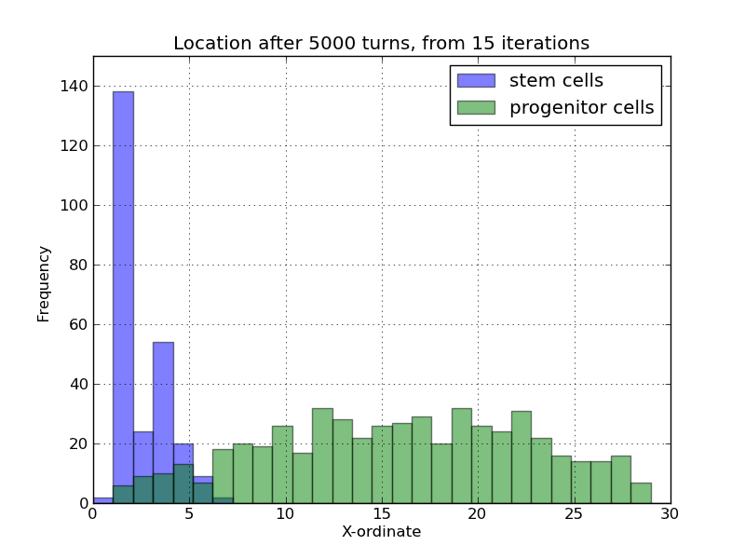
Example: Stem Cell Replication

Slide 16
Example: Macrophage Migration

Slide 17
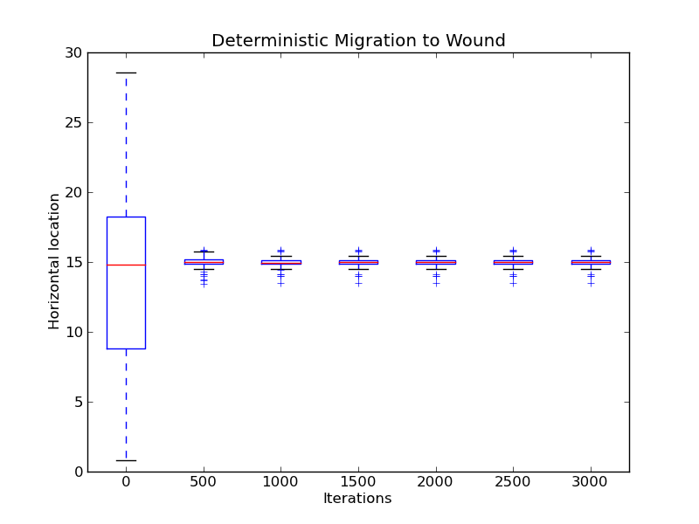
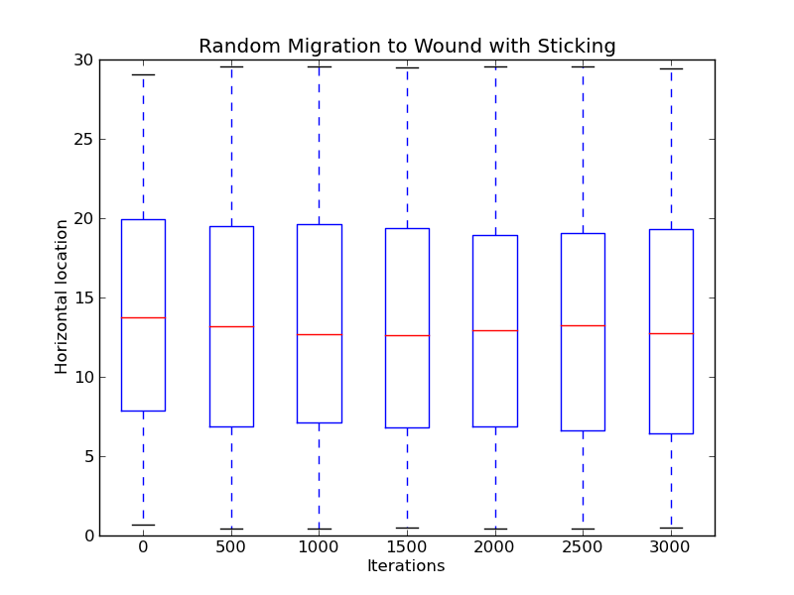
Example: Macrophage Migration

Slide 18
References
Kaul, Himanshu, and Yiannis Ventikos. "Investigating biocomplexity through the agent-based paradigm." Briefings in bioinformatics 16.1 (2015): 137-152.
18

